Slide 1
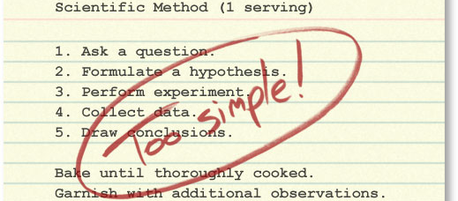
MODULE 5
Scientific investigations

Slide 2

MODULE INTRODUCTION
Students learn that the experimental method is a dynamic process influenced by initial observations, new evidence, unexpected results or phenomena arising from the investigation. They examine the interrelated roles of practical and secondary-sourced investigations. When conducting practical and secondary-sourced investigations, students use peer feedback to refine their investigative designs and report on their findings. Students explore the importance of accuracy, validity and reliability in relation to the investigative work of a scientist. They examine the differences between a scientific investigation and a scientific report, recognising that although the report format follows a sequential order, the investigation need not. In this module, students focus on: developing and evaluating hypotheses and questions; designing and evaluating investigations, and undertaking valid scientific investigations. Students should be provided with opportunities to engage with all Working Scientifically skills throughout the course.

Slide 3
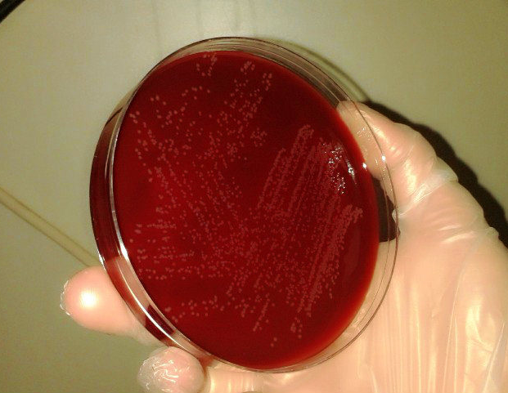
EQ1: WHAT INITIATES AN INVESTIGATION?
Research the factors( below) that led scientists to investigate the following, including but not limited to:
peptic ulcers (Marshall and Warren)
plant growth (Von Helmont)
microwaves (Spencer)

Slide 4
Research the factors( below) that led scientists to investigate the following, including but not limited to:
peptic ulcers (Marshall and Warren)
plant growth (Von Helmont)
microwaves (Spencer)
for example( choose the most relevant points for each example above).
finding relationships or patterns in identified phenomena
testing the conclusion of a previous investigation
utilising scientific knowledge and understanding to make more accurate predictions and develop new technologies
determine the hypotheses that were tested in each of the scientific investigations above.
describe where deviations from the traditional and linear models of scientific methodology were necessary in order to test each hypothesis in the investigations above.

Slide 5

GREAT BACKGROUND READING: A BLUEPRINT FOR SCIENTIFIC INVESTIGATIONS, FROM THE UNIVERSITY OF BERKELEY. THIS IS PART OF A SERIES OF PAGES ON HOW SCIENCE WORKS.
An interesting TED-ed talk. People often credit their ideas to individual “Eureka!” moments. But Steven Johnson shows how history tells a different story. His fascinating tour takes us from the “liquid networks” of London’s coffee houses to Charles Darwin’s long, slow hunch to today’s high-velocity web.

Slide 6
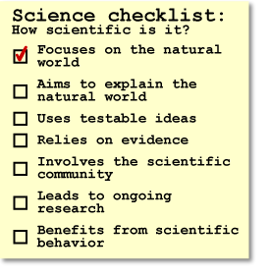
WHAT INITIATES AN INVESTIGATION?
A science investigation is a deliberate and organised process to try and answer a scientific question. However the way questions arise vary.
From this new scientific theories may emerge. A scientific question is one that can only be answered by a scientific investigation. It needs to be able to address the points on the right/
Where do these ideas come from? Think and write down some ideas in your book.

Slide 7
IDEAS NOTES FROM OUR CLASS
1.
2.
3.
4.
5.
6.

Slide 8
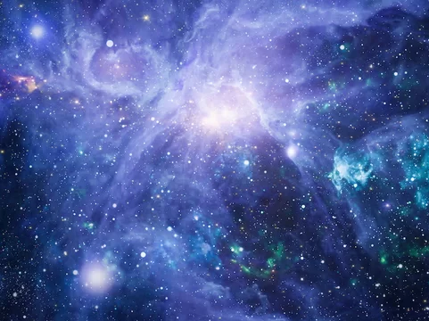
WHAT INITIATES AN INVESTIGATION?
There are many factors that can initiate investigations. Some of these include;
Looking for or understanding more relationships and or patterns between variables.
Testing others conclusions and hypothesis.
New technologies and innovations that can measure more acutely and with more precision.
The quest of discovery, to find what is not known.

Slide 9
THIS IS NOT HOW SCIENCE WORKS
How we write science investigations and how we think about solving a scientific problem are two very different things

Slide 10
CORRECTING SOME MISCONCEPTIONS
1. The simplified, linear scientific method implies that scientific studies follow an unvarying, linear recipe.
But in reality, in their work, scientists engage in many different activities in many different sequences. Scientific investigations often involve repeating the same steps many times to account for new information and ideas.
2. The simplified, linear scientific method implies that science is done by individual scientists working through these steps in isolation.
But in reality, science depends on interactions within the scientific community. Different parts of the process of science may be carried out by different people at different times.

Slide 11

3. The simplified, linear scientific method implies that science has little room for creativity. But in reality, the process of science is exciting, dynamic, and unpredictable. Science relies on creative people thinking outside the box!
4. The simplified, linear scientific method implies that science concludes. But in reality, scientific conclusions are always revisable if warranted by the evidence. Scientific investigations are often ongoing, raising new questions even as old ones are answered.

Slide 12

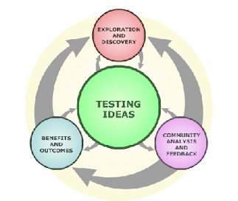
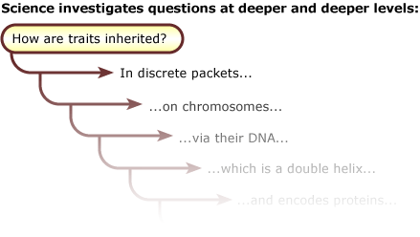
SCIENCE IS A PROCESS OF FINDING OUT THE FACTS BY ASKING AND INVESTIGATING SCIENTIFIC QUESTIONS

Slide 13
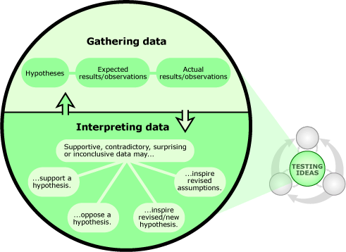
Scientific testing is at the heart of the process.
In science, all ideas are tested with evidence from the natural world, which may take many different forms — from Antarctic ice cores, to particle accelerator experiments, to detailed descriptions of sedimentary rock layers. You can't move through the process of science without examining how that evidence reflects on your ideas about how the world works — even if that means giving up a favourite hypothesis.
https://undsci.berkeley.edu/article/coreofscience_01

Slide 14
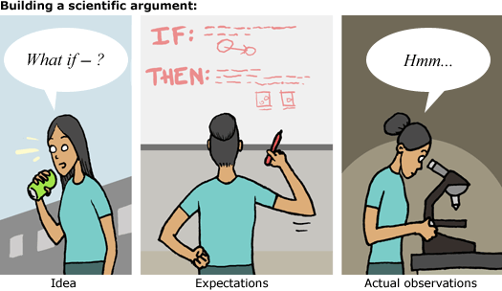
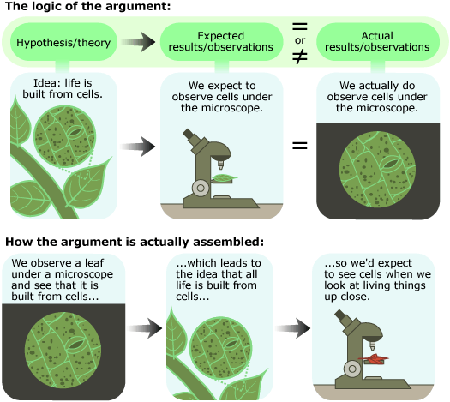
1. What would we expect to see if this idea were true (i.e., what is our expected observation)?
2. What do we actually observe?
3. Do our expectations match our observations?
In academic writing and discussions an Argument refers not to a disagreement between two people, but to an evidence-based line of reasoning

Slide 15
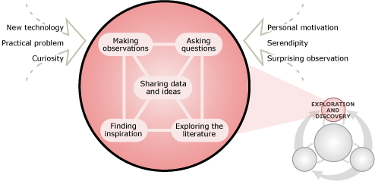
There are many routes into the process — from serendipity (e.g., being hit on the head by the proverbial apple), to concern over a practical problem (e.g., finding a new treatment for diabetes), to a technological development (e.g., the launch of a more advanced telescope) — and scientists often begin an investigation by plain old poking around: tinkering, brainstorming, trying to make some new observations, chatting with colleagues about an idea, or doing some reading.
https://undsci.berkeley.edu/article/_0_0/howscienceworks_03

Slide 16
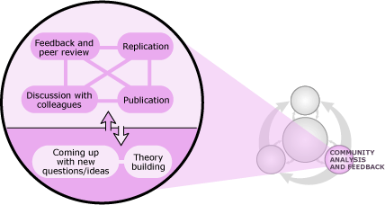
The scientific community helps ensure science's accuracy. Members of the scientific community (i.e., researchers, technicians, educators, and students, to name a few) play many roles in the process of science, but are especially important in generating ideas, scrutinizing ideas, and weighing the evidence for and against them. Through the action of this community, science is self-correcting.
https://undsci.berkeley.edu/article/_0_0/howscienceworks_03

Slide 17
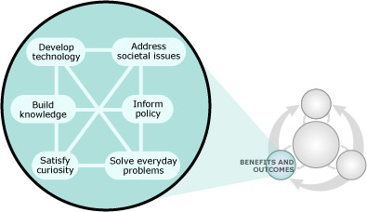
The process of science is intertwined with society. The process of science both influences society (e.g., investigations of X-rays leading to the development of CT scanners) and is influenced by society (e.g., a society's concern about the spread of HIV leading to studies of the molecular interactions within the immune system)
https://undsci.berkeley.edu/article/_0_0/howscienceworks_03

Slide 18

Click on the link to read about it in more detail
https://undsci.berkeley.edu/article/_0_0/howscienceworks_02
A real life example of the non-linear process of science (5:53)
https://www.calacademy.org/explore-science/how-science-works
Watch and write down why science is not a linear process

Slide 19
Research the factors that led scientists to investigate the following, including but not limited to:
peptic ulcers (Marshall and Warren)
plant growth (Von Helmont)
microwaves (Spencer)
Notes:
Start here term 1 2019- go through responses.

Slide 20
PEPTIC ULCERS (MARSHALL AND WARREN) TEXTBOOK P 39-40
the man who tried to give himself an ulcer for science, youtube video.
1. What initiated the investigation into peptic ulcers?
2. What was initially thought to to cause ulcers?
3. How did the scientist aim to test the ideas you wrote about in question 2?
4. What was tested and how was it tested?
5. What where some outcomes in terms of development of new ideas and technologies, of this investigation into peptic ulcers?

Slide 21
WHAT CAUSES PLANT GROWTH( VAN HELMONT) TEXTBOOK P 41-43
Van Helmont’s experiment: Veritasium
https://www.youtube.com/watch?v=2KZb2_vcNTg&ab_channel=Veritasium
1. What was Van Helmont trying to demonstrate with his investigation?
2. How did he try to determine the answer to his questions?
3. What new ideas came about after his experiment?

Slide 22
MICROWAVES( SPENCER) TEXTBOOK PAGES 43-44
01 Microwave Oven: Accidental Inventions Documentary youtube
1.What factors led to the discovery of microwave oven?
2.What experiments were conducted in order to draw a valid conclusion from initial observations mentioned above?
3.What new technologies and ideas came about after this investigation?

Slide 23
INVESTIGATING MICROWAVES P.44
How To Calculate The Speed Of Light With Your Microwave
https://www.youtube.com/watch?v=GH5W6xEeY5U

Slide 24
REVIEW PAGE 45
Complete these questions

Slide 25
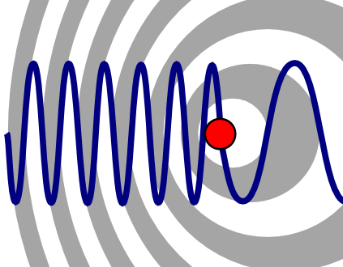
EQ 2 WHAT TYPE OF METHODOLOGY BEST SUITS A SCIENTIFIC INVESTIGATION?
Using examples, evaluate the objectives and data collected in an investigation by a recognised scientist or team of scientists, including but not limited to:
Marshal and warren peptic ulcers
Eratosthenes and Earth’s circumference
Doppler and the Doppler effect
Priestley’s experiments with oxygen

Slide 26
MARSHAL AND WARREN AND PEPTIC ULCERS THE DOCTOR WHO DRANK INFECTIOUS BROTH, GAVE HIMSELF AN ULCER, AND SOLVED A MEDICAL MYSTERY
Marshall wanted to find the underlying causes of ulcers. Surgery records and patient records and X rays indicated existence of ulcers. He challenged the hypothesis at the time as it was believed that smoking and lifestyle stress were the main contributing factors. Further evidence came from observations made by Robin Warren. He said had been seeing bacteria on biopsies of ulcer and stomach cancer patients for two years, and they were all identical.
All the microorganisms all had an S-shaped or helical form, and the infections coated the stomach. Warren had found them in about 20 patients who had been sent to him because doctors thought they might have cancer. Instead of cancer, he had found a type of bacteria. Warren let Marshall investigate the patient records to see if there was any data that could explain the patterns he has been observing.

Slide 27
Eventually a patient turned up to Marshall who was in severe pain and was deemed to have symptoms of angina. There was little treatment available at the time and he was given an antibiotic, tetracycline. After 2 weeks he came back and was healed of pain. This made Marshall infer that perhaps bacteria may be the cause of some of these painful symptoms. He set up a proper clinical trial of 100 people.
Marshall got an excited call from the microbiologist who was studying the cultures. The lab technicians had been throwing the cultures out after two days (as it was standard practice), however Helicobacter is slow-growing, as they discovered. After Marshal and the microbiologist realised this they let the cultured grow longer. They found that the13 patients that had duodenal ulcer all of had the bacteria.
Marshall and Warren observed that everybody who got stomach cancer developed it on a background of gastritis, an irritation or inflammation of the stomach lining. Whenever they found a person without Helicobacter, they couldn’t find gastritis, either. So as far as they knew, the cause of gastritis was Helicobacter. Therefore, it had to be the most important cause of stomach cancer as well.
How did the data collected by Marshal and Warren support their initial hypothesis of heliobacteria being the cause of stomach ulcers?

Slide 28
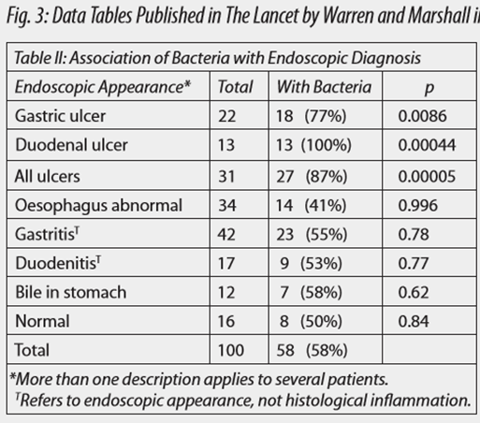


Slide 29
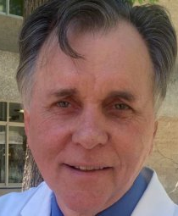
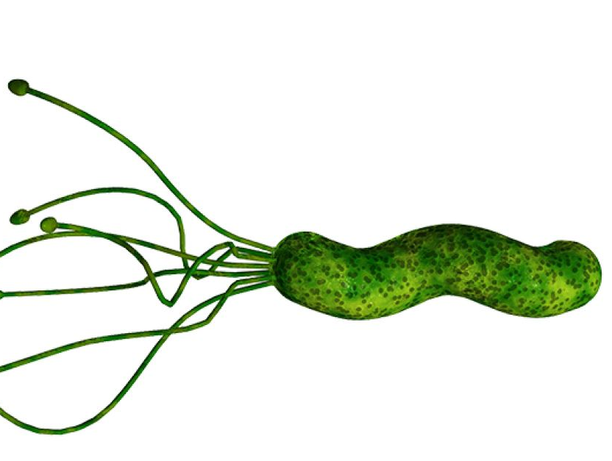
HIS WORKS CONTINUES, 2017
https://www.abc.net.au/news/2017-04-04/researchers-who-discovered-heliobacter-learn-more-about-bacteria/8415686
“Professor Marshall and a team of researchers at the University of Western Australia have identified how the bacteria produces a waxy shield which protects it from stomach acid, allowing it to survive for long periods of time.
Understanding the makeup of the waxy shield will allow for the development of treatments to stop the bacteria surviving in the stomach, which Professor Marshall said would help remove H. pylori from the human population.”
“H. pylori is classified as a class 1 carcinogen in Australia, which means it is proven to cause cancer, even in those who do not experience ulcers.”

Slide 30
ERATOSTHENES AND EARTH’S CIRCUMFERENCE
https://www.youtube.com/watch?v=Mw30CgaXiQwHow Eratosthenes calculated the Earth's circumference.
This text is from KHAN academy notes
https://www.khanacademy.org/partner-content/big-history-project/solar-system-and-earth/knowing-solar-system-earth/a/eratosthenes-of-cyrene
More than 2,000 years ago Eratosthenes compared the position of the Sun’s rays in two locations to calculate the spherical size of the Earth with reasonable accuracy. He computed this by using simple geometry and trigonometry and by recognizing Earth as a sphere in space. Most Greek scholars by the time of Aristotle (384–322 BCE) agreed that Earth was a sphere, but none knew how big it was.
How did Greek scholars know the Earth was a sphere? They observed that ships disappeared over the horizon while their masts were still visible. They saw the curved shadow of the Earth on the Moon during lunar eclipses. And they noticed the changing positions of the stars in the sky.

Slide 31
Measuring the Earth
Eratosthenes heard about a famous well in the Egyptian city of Swenet (Syene in Greek, and now known as Aswan), on the Nile River. At noon one day each year — the summer solstice (between June 20 and June 22) — the Sun’s rays shone straight down into the deep pit. They illuminated only the water at the bottom, not the sides of the well as on other days, proving that the Sun was directly overhead. (Syene was located very close to what we call the Tropic of Cancer, ~23.5 degrees north, the northernmost latitude at which the Sun is ever directly overhead at noon.)
Eratosthenes erected a pole in Alexandria, and on the summer solstice he observed that it cast a shadow, proving that the Sun was not directly overhead but slightly south. Recognizing the curvature of the Earth and knowing the distance between the two cities enabled Eratosthenes to calculate the planet’s circumference.

Slide 32
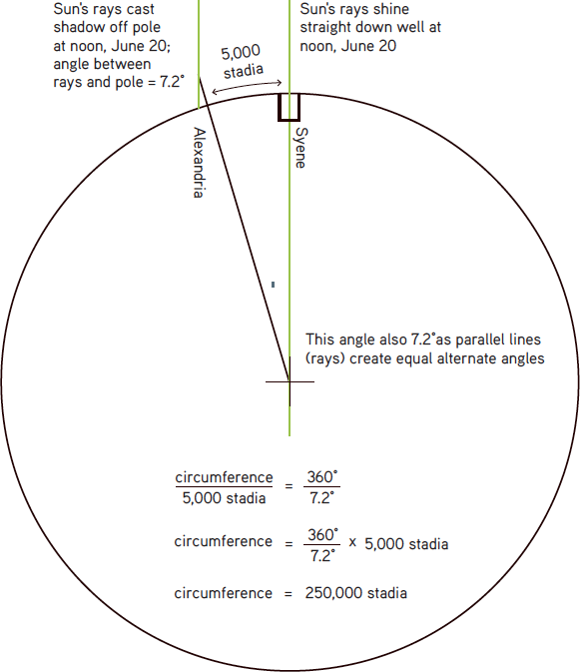
Eratosthenes could measure the angle of the Sun’s rays off the vertical by dividing the length of the leg opposite the angle (the length of the shadow) by the leg adjacent to the angle (the height of the pole). This gave him an angle of 7.12 degrees. He knew that the circumference of Earth constituted a circle of 360 degrees, so 7.12 (or 7.2, to divide 360 evenly by 50) degrees would be about one-fiftieth of the circumference. He also knew the approximate distance between Alexandria and Syene.
We don’t use stadia today.
The distance was actually about 800KM so that could be placed in the equation to get 40,000 km.
The actual distance is 40,075 km.
How did the data collected help him solve the problem of the Earths circumference?

Slide 33
INVESTIGATING MEASUREMENTS USING SHADOWS PAGE 47
Aim: To determine the height of a tall object using shadows
Materials: 30 m tape measure
Method: https://www.youtube.com/watch?v=8-Vv-fAsuaY
Write down the method from the video and conduct the investigation, refine the method as needed.
Results:
Discussion:
Conclusion :

Slide 34
DOPPLER AND THE DOPPLER EFFECT P 48-50
https://micro.magnet.fsu.edu/optics/timeline/people/doppler.html
The discovery of the Doppler effect by Christian Doppler(1803-1853) is central to modern conceptions of sound and light.
His earliest work concerned mathematics, but in 1842 Doppler completed and published the paper On the Coloured Light of Double Stars and Certain Other Stars of the Heavens. Within the work, he proposed that observed frequency of light and sound waves is dependent upon how fast the source and observer are moving relative to each other, a phenomenon commonly referred to as the Doppler effect. He also correctly predicted that his theory would some day be utilized by astronomers to more accurately measure the movements and distances of stars.

Slide 35
Doppler's ideas were initially received with a certain amount of skepticism so, in order to support his claims, he devised an extremely unusual experiment. In 1845, with the help of a colleague, Doppler arranged for a train to carry an open car full of trumpeters back and forth along a section of track. Alongside, another group of musicians stood by and recorded their perceptions of the pitch of the instruments. The innovative test proved successful, confirming Doppler's prediction that as the trumpets approached the musicians heard a higher pitch, which became noticeably lower as the train passed by.
Demonstrating that the Doppler effect also held true for the frequency of light proved more difficult and was never successfully achieved before Doppler's death in 1853. The first experiment that revealed a Doppler shift in starlight was carried out at the beginning of the twentieth century. Since that time, however, the Doppler effect has proven invaluable for astronomical observations, paving the way for a host of new scientific discoveries and concepts. Most notably, the motions of stars detected through this manner led to the development of the big bang theory of the universe.
What method did Doppler use to demonstrate his hypothesis? How effective was the data gathered at supporting his hypothesis?
Doppler Effect- Bozeman science applications of the doppler effect
https://www.youtube.com/watch?v=kdiHmSWI2Ks

Slide 36
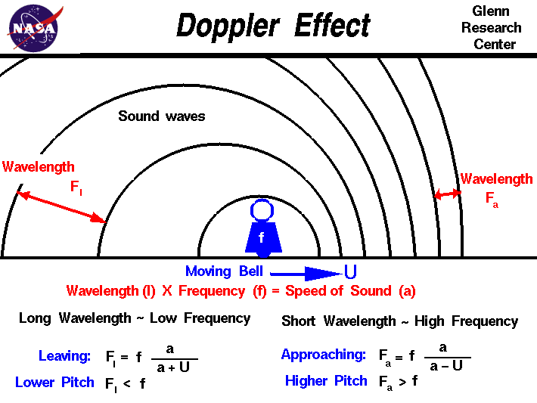

Slide 37
INVESTIGATING THE DOPPLER EFFECT P 49
Aim:
Materials:
Method:
Results:
Discussion:
Conclusion:

Slide 38
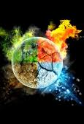
PRIESTLEY’S EXPERIMENTS WITH OXYGEN P 51-52 HTTPS://WWW.ACS.ORG/CONTENT/ACS/EN/EDUCATION/WHATISCHEMISTRY/LANDMARKS/JOSEPHPRIESTLEYOXYGEN.HTML
Some 2,500 years ago, the ancient Greeks identified air — along with earth, fire and water — as one of the four elemental components of creation. That notion may seem charmingly primitive now. But it made excellent sense at the time, and there was so little reason to dispute it that the idea persisted until the late 18th century. It might have endured even longer had it not been for a free-thinking English chemist and maverick theologian named Joseph Priestley.

Slide 39
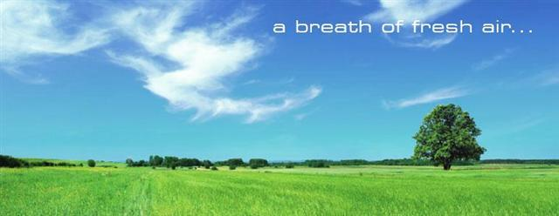
The world recalls Priestley best as the man who discovered oxygen, the active ingredient in our planet's atmosphere. In the process, he helped dethrone an idea that dominated science for 23 uninterrupted centuries: Few concepts "have laid firmer hold upon the mind," he wrote, than that air "is a simple elementary substance, indestructible and unalterable."
In a series of experiments culminating in 1774, Priestley found that "air is not an elementary substance, but a composition," or mixture, of gases. Among them was the colourless and highly reactive gas he called "dephlogisticated air," to which the great French chemist Antoine Lavoisier would soon give the name "oxygen."
In the mid-18th century, the concept of an element was still evolving. Researchers had distinguished no more than two dozen or so elements, depending on who was doing the counting. It wasn't clear how air fit into that system. Nobody knew what it was, and researchers kept finding that it could be converted into such a variety of forms that they routinely spoke of different "airs."
The principal method for altering the nature of air, early chemists learned, was to heat or burn some compound in it.

Slide 40
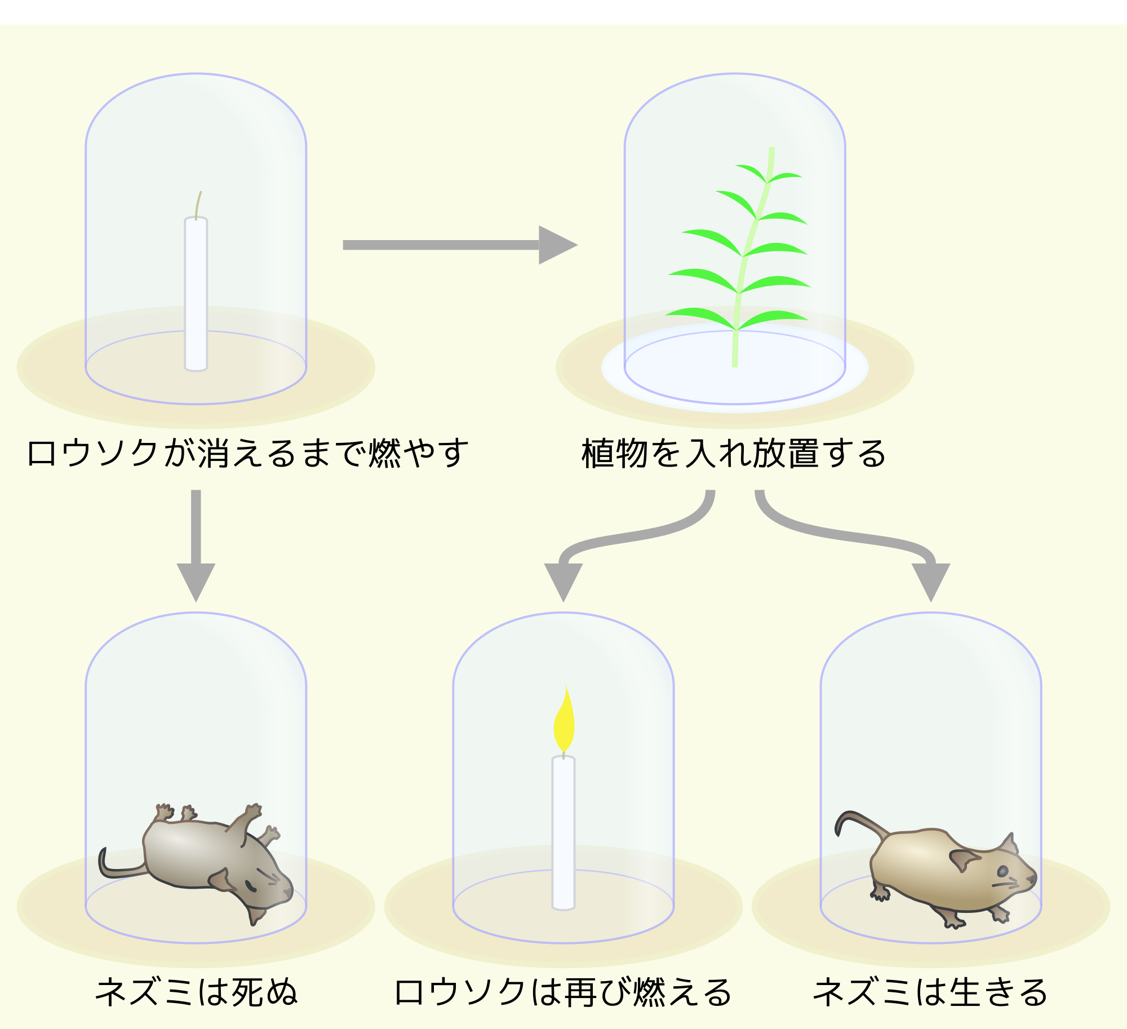
THE JOURNEY OF DISCOVERY
Priestley systematically analysed the properties of different "airs" using the favoured apparatus of the day: an inverted container on a raised platform that could capture the gases produced by various experiments below it. The container could also be placed in a pool of water or mercury, effectively sealing it, and a gas tested to see if it would sustain a flame or support life.
In the course of these experiments, Priestley made an enormously important observation. A flame went out when placed in a jar in which a mouse would die due to lack of air. Putting a green plant in the jar and exposing it to sunlight would "refresh" the air, permitting a flame to burn and a mouse to breathe. Perhaps, Priestley wrote, "the injury which is continually done by such a large number of animals is, in part at least, repaired by the vegetable creation." Thus he observed that plants release oxygen into the air — the process known to us as photosynthesis.

Slide 41
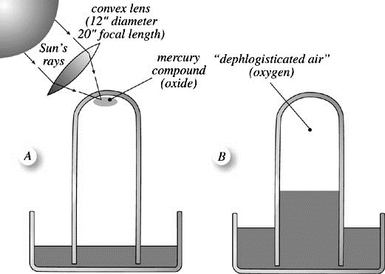
On August 1, 1774, he conducted his most famous experiment. Using a 12-inch-wide glass "burning lens," he focused sunlight on a lump of reddish mercuric oxide in an inverted glass container placed in a pool of mercury. The gas emitted, he found, was "five or six times as good as common air." In succeeding tests, it caused a flame to burn intensely and kept a mouse alive about four times as long as a similar quantity of air.
Priestley called his discovery "dephlogisticated air" on the theory that it supported combustion so well because it had no phlogiston in it, and hence could absorb the maximum amount during burning. (The year before, Swedish apothecary Carl Wilhelm Scheele isolated the same gas and observed a similar reaction. Scheele called his material "fire air." But his findings were not published until 1777.)
Whatever the gas was called, its effects were remarkable. "The feeling of it in my lungs," Priestley wrote, "was not sensibly different from that of common air, but I fancied that my breast felt peculiarly light and easy for some time afterwards. Who can tell but that in time, this pure air may become a fashionable article in luxury. Hitherto only two mice and myself have had the privilege of breathing it."

Slide 42

http://www.mysteryofmatter.net/Priestley.html
Film Clip: A Mysterious New Gas - Priestley finds a new gas in which candles burn longer and brighter than in ordinary air.
Film Clip: "Super Air" - With the help of a mouse, Priestley discovers this air is more “light and easy” to breathe than ordinary air.
How did Priestley’s method help change the idea that air was an element?

Slide 43
INVESTIGATION: MAKING OXYGEN P 53
Aim:
Materials:
Method:
Results:
Discussion:
Conclusion:

Slide 44
EVALUATE THE METHODOLOGY OF THE SCIENTIFIC INVESTIGATIONS P 54-55
1. Justifying( give reasons based on evidence) the method chosen based on the subject of the investigation and the context, for example, experimental testing, fieldwork, locating and using information sources, conducting surveys and using modelling and simulations.
Putting the information into a table will help you organise your ideas.
Investigation | Give reasons for the choice of method. Ensure that you base your reasons on what the investigation was about( subject)and the idea/theory etc. that they where trying to understand and explain( context)
Peptic ulcers
Circumference of earth
Doppler effect
Priestly and oxygen

Slide 45
2. Evaluating the relevance of the investigation by considering the peer-reviewed literature in the area of study justifying the suitability of the type of data that is to be collected.
It might be useful to make this summary into a table as well.
Investigation | How good was the investigation at answering the question. Consider what was known at the time in the area of each investigation.
Peptic ulcers
Circumference of the earth
Doppler effect
Priestly and oxygen

Slide 46
REVIEW QUESTIONS P 56

Slide 47
STUDENT INVESTIGATION( P 56-60 REFERENCE)
Students:
develop a method most appropriate to test a hypothesis following observation
justify the type of methodology used to test the hypothesis

Slide 48
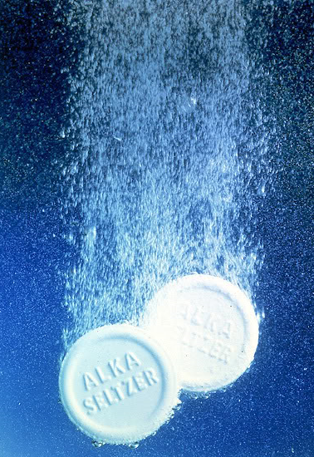
PRACTICE INVESTIGATION: REACTION RATES
Aim: To the investigate the effect of increasing temperature on the reaction rate of Alka Selzter tablets.
Materials:
Method: individually design a method that will measure reaction rate in a reliable and accurate manner.
Results (construct a table and graph of your results)
Analysis of the results (this is often found in scientific papers either separately or as part of the discussion).
1. Justify the reliability of your results, i.e. How did your method enable your results to be reliable? How do you know?
2. Justify the accuracy of the results, i.e. How did your method enable your results to be accurate? How do you know?
3. Evaluate the validity of your method.

Slide 49
ETHICS IN INVESTIGATIONS P 66-68
Consider the ethical implications of scientific investigations.
Peptic ulcers
Priestly’s experiments with mice
Other experiments, such as genetic engineering and testing medicines on animals and trials conducted on humans.
How will you determine ethical practice in your own investigations?

Slide 50
TIME MANAGEMENT AND HUMAN RESOURCES P 68-70
1. How will you manage your time?
2. Pros and cons of working individually or as a team
 | Positive | Negative
Individually
Team

Slide 51

EQ3 RELIABILITY AND VALIDITY
Inquiry Question 3: How is the integrity of a scientific investigation judged?
Textbook reference pages 56-

Slide 52
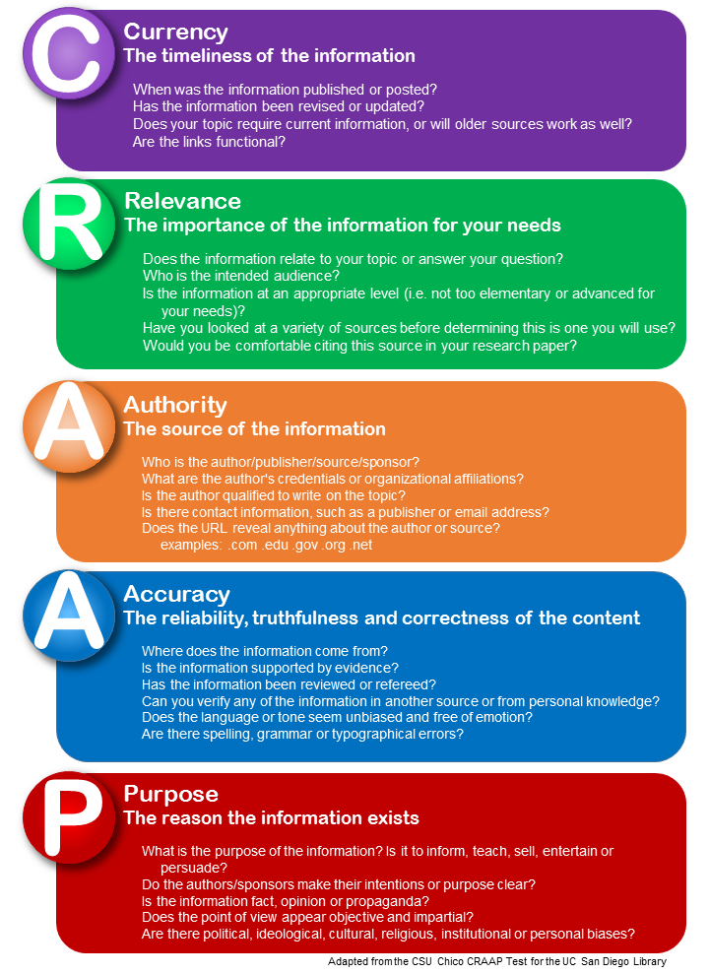
SOURCES OF INFORMATION
Primary data is information gathered from your own experiments. Secondary data is data gathered from others investigation. Use the CRAAP guide when evaluating your secondary data.

Slide 53

COMING UP WITH THE HYPOTHESIS
A hypothesis is a statement that can be tested with a valid scientific method. The results may agree or disagree with the hypothesis and enable further areas of research.
A hypothesis is developed by coming up with questions about a phenomena. A good way is to ask questions that start with the following words in no particular order. These questions can also be researched to come up with questions that focus the investigation in a particular area.

Slide 54

EXAMPLE THINKING SCAFFOLD
General questions about an observation seen or information read
Research and find out more
More specific questions about an investigation
Research and find out more
Several specific areas of interest that generate questions that generate hypothesis that adds to societal scientific understanding.

Slide 55
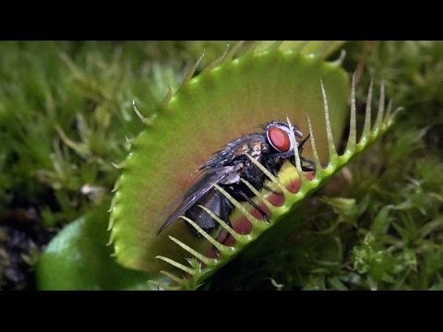

Your turn to come up with some questions following this observation.

Slide 56



TURNING YOUR QUESTIONS INTO TESTABLE HYPOTHESES
The questions need to contain variables that can be measured in a reliable and accurate using the technology/expertise available. You need to be able to account for these in your analysis of the data.
From these questions you may decide on one or several hypothesis that contain ONE variable that can be changed(IV)and how this variable may affect other variables.(DV).
You need to decide which of these can be tested in a valid way. This means developing a valid method to test your hypothesis. Expect your method to change and refine as you conduct an investigation.

Slide 57
METHODOLOGY IN SCIENCE
A methodology is a system of methods used in a particular area of study or activity. In science it is how you go about investigating your hypothesis, aim or inquiry.
We are being asked to
develop a method most appropriate to test a hypothesis following observation
justify the type of methodology used to test the hypothesis
This would involve
Writing a valid method to address the hypothesis.
Ensuing that you use accurate and reliable Measurement/Lab skills
Recording, analysing and presenting data in a non biased way
Comparing your method to what is found in the literature to determine wether your results are valid.

Slide 58
CHOOSING VARIABLES
Consider the following;
What you measure- dependent variable( can be more than one if measuring effects on several things to test efficacy)
What you keep the same- controlling variables( always many)
What you change- independent variable ( only one for year 12, as you need a deeper understanding of statistics to do more)
Do you need a control? Are you comparing a response to a treatment? Then you need a control.

Slide 59
SAMPLE SELECTION AND SAMPLE SIZE
Consider;
How you will minimise bias and potential systematic and random error.
Go back and revisit these concepts to help you (Module 6). How would you minimise these and how does this affect sample selection and size?
What is your sample size (trials) that you would you need to minimise error and bias in your results?
Which samples will you choose to get your data?

Slide 60
CHOOSING MATERIALS/TECHNOLOGIES AND RISK ASSESSMENT
Justify the materials you would choose- think about
Why are you using these materials?
How will using these materials help you answer your research question?
Are there any ethical concerns? How will you address these?
Think about controlling error, reducing bias, safety and your level of expertise in using technologies.

Slide 61
PLANNING YOUR METHOD/RECORDING DATA
1. How and where will you record your data?
2. How will you present your data?
Construct your method , consider your answers here, the previous 4 parts and the actual research question.
You method must show evidence of how you will collect your data and how you will ensure that your data is valid.
You do not explain your reasons in your method, this is done in the data analysis section in the in the Discussion.

Slide 62
THE AIM OF THE INVESTIGATION
Once you have developed your valid method that will test your hypothesis you will need to construct an aim.
The aim can be written with this beginning;
To investigate….
To find out…
To determine….
It must relate the independent variable(IV) to the dependent variable(DV) in the same way your hypothesis does. This would also be reflected in your results table and graphs. By convention IV is written before DV.

Slide 63
RESULTS-DETAILED DESCRIPTION OF WHAT HAPPENED.
Your results should include data and no explanations.
Does the data can include images with captions and tables and graphs with headings?
Does the data show the averages only?, Is the raw collected documented ?How can you prove that you conducted the investigation- you need detailed observations and these need to be recorded in a journal or on a special journal file on your computer.
Are there should be several short statements that describe your results including any relevant relationships between the variables?

Slide 64
DISCUSSION- THE EXPLAINING PART OF THE REPORT
This is where you will be.
1.Analysing the results and interpreting the data- consider errors and potential bias introduced. For example, having sample selection that is too small.
2.Justifying the methodology and any changes made to improve the data collected. Consider the reliability of the method in regards to;
the consistency of the results obtained
measures are taken to reduce error
3. Explaining the relevance of the findings of the investigation in relation to the inquiry question and hypothesis- this relies on your background information as well

Slide 65
PRESENTING RESULT TABLE
Include a heading- this should be similar to the one for your graph as well
IV on the left, DV on the right in columns indicating trials( including any controls, Averages on the far right. See page 71 for examples
Avoid shading keep it neat and simple
Present your averages omitting trials in submitted reports

Slide 66
PRESENTING GRAPHS
Include a heading
IV on the x axis with heading and units
DV on the y axis with heading and units
Key in graphs with multiple DV
Caption underneath describing what the graph is about. e.g.This graph shows the effect of ….)
Keep it simple avoid 3D effects too many colours, shading ect. The data must be easy to read.
Learn to use excel to graph
See examples on page 71-72.

Slide 67
CONCLUSION – KEEP IT BRIEF
Consider the following
1.Evaluate the validity of the investigation by determining whether the tests measured what they were intended to measure.
Did the results support the hypothesis and actually address the aim of the investigation?
2. Describing potential beneficial and harmful consequences when the findings are applied to a real-world scenario.
How would you apply the findings in the real world? Are there any potential consequences? (See page 75-76 for some pointers)

Slide 68

EQ4 REPORTING
Inquiry question 4: What is the structure of an investigative report?

Slide 69
SYLLABUS
Review a published and peer-reviewed scientific report to determine the conventions of writing a report on a practical investigation. This link is about how to write a scientific paper and includes information about the purpose of each section and what each section should have in it in order to meet the conventions of scientific writing.
use a sample of a published and peer-reviewed secondary source to identify:
the purpose of the report
measures are taken to reduce error
the language style used
the presentation and structure of the report
compare and contrast the structures and functions of a scientific investigation and its written report
Prepare a report on the student investigation that was carried out (in our case its the Alka seltzer tablets investigation)

Slide 70
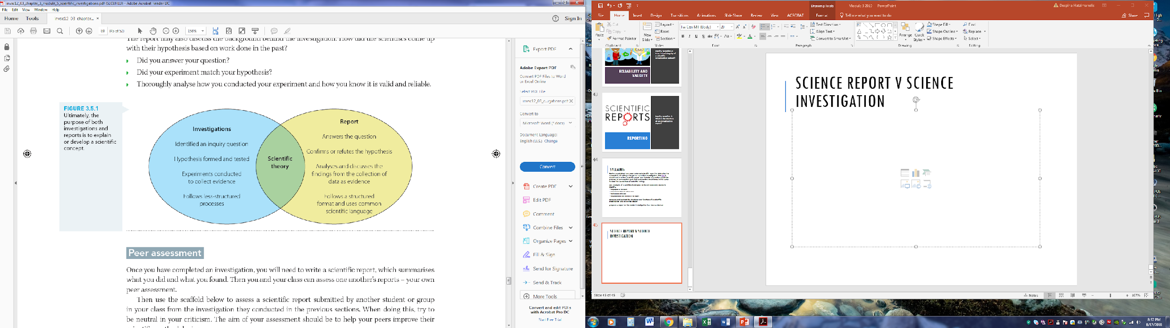
SCIENCE REPORT vs SCIENCE INVESTIGATION, P 80

Slide 71
SCIENTIFIC REPORTS
https://www.waikato.ac.nz/library/study/guides/write-scientific-reports
Elements of a Scientific Report
Title Page
Table of Contents
Abstract
Introduction
Materials and Methods (Experimental)
Results
Discussion
Conclusion
References

Slide 72
EXAMPLE
Use a sample of a published and peer-reviewed secondary source to identify:
the purpose of the report
measures are taken to reduce error
the language style used
the presentation and structure of the report
IS webpage section- writing for science
COSMOS magazine, how to read a scientific paper.
https://cosmosmagazine.com/technology/checking-the-source-how-to-read-a-scientific-paper
Also see module 7- popular science v scientific report comparison lesson in edrolo

Slide 73
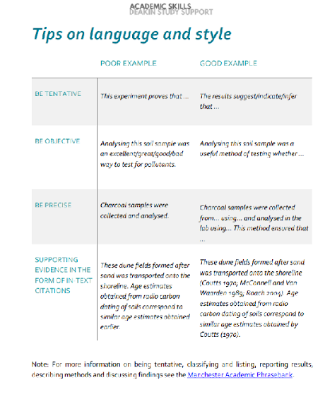
https://www.deakin.edu.au/__data/assets/pdf_file/0018/1003491/Science_Guide-to-Writing-Lab-and-Field-Reports.pdf

Slide 74





YOUR TURN – DEPTH STUDY INVESTIGATION
Your task is to develop a hypothesis based on observation/research that can be tested in a valid way.
You will be designing and completing the investigation individually however you may help each other if you need help to do the investigation safely.
You will then be writing the investigation in a scientific report format similar to formal scientific literature.
You will also be required to log your investigation development in a log book or science journal each lesson or time you do something regarding the investigation.
See your assessment task for more detail and support materials in google drive.

